Slide 1
UHV-I Session 12 Understanding Role in Society
Contributing towards fulfilment of a common human goal in the society (institution… state… nation… world)

Slide 2
Interaction Before Main Session
Hear from participants about their exploration from previous day(s)
Q&A
Place some expected conclusions, find out if they also came to these/similar conclusions

Slide 3
Home Assignments
11.1. Suggest ways in which we can develop affection among
Different batches in your institute
Students of the same batch
11.2. Make a list of people that you take inspiration from.
Evaluate if they are living in harmony or making effort to do so
Evaluate the feeling you have for them: is it over, under or otherwise evaluation?
Evaluate if they are helping others to live in harmony
Note a few things that you would you like to learn from them
List a few steps that you need to take to work for excellence
11.3. Make a list of people in your family, in the college and in the larger society who are directly and indirectly participating in fulfilling your needs. What is your feeling for them, how is your interaction with them, what is your contribution (in terms of understanding, feeling and physical facility) to them?
11.4. Distinguish between Love and Infatuation
What do you mostly think about? Love or Infatuation (or something else)?

Slide 4
UHV-I Session 12 Understanding Role in Society
Contributing towards fulfilment of a common human goal in the society (institution… state… nation… world)

Slide 5
Concerns
So far, I was protected by my parents. Now I have to face the society all by myself. Will I be able to do it?
How can there be communal harmony in the society?
How can the society be free of crimes, especially crimes against women?
How can I play a vital role in making a corruption free society?
There is a vast gap between rich and poor in the society. What could be the solution to this?
How do I make my country have better relations with its neighbors?
What areas do I pick for innovation and research which can be useful for the society at large?
How do I take my parental family and my future family together while on job?
Society has various systems: education, health, market, governance, judiciary, media, public services… Can I have a holistic understanding for all these systems and my role therein?
…
If you have any other concerns,
please feel free to share them

Slide 6

Present State
Many times we work with a limited vision: me, my family, my job, my career, enjoyment at workplace and in family etc.
But real life is not just this.
In real life, we have to face the society in multiple ways
When we do not have a holistic vision of society and we are faced with some disturbing issues, we try to fight against the problems, many times we start feeling lonely
Can there be a holistic vision for a harmonious society, a harmonious world?
Unless my vision is clear, how do I pick my role in it?
Hence, I need to understand the common goal of human beings living in the society together

Slide 7
Introduction
In the previous sessions, we
Discussed about Harmony at the level of Individual and Family
We saw that -
Basic aspiration of every human being is continuity of happiness and prosperity
Trust is the foundation of every relationship
The feeling of Love is the foundation of Undivided Society
If we understand this, then we make effort for it – individually, in the family and in the larger society
In this session, we want to explore the goal of human being living in society, so that desirable systems required for it may be developed and effectively implemented (to be explored in subsequent UHV courses).

Slide 8
What is Society and Where are we today?
Families living together, in a relationship of mutual fulfillment
(common goal)
Society
People living together, but not in relationship of mutual fulfillment
(differing goals)
Crowd
People living separately, in opposition / struggle
(conflicting goals)
Battlefield
We will explore harmony in society –
The base of harmony in society is harmony in family
for which the base is harmony in human being
Notes:
Key point is that we will explore society = families living together, in a relationship of mutual fulfillment and making effort for a common human goal

Slide 9
Society
Society is composed of many families living together making a collective effort for a common goal
With clarity, commitment and collective effort for the common human goal, a humane society can be realised
A humane society is the result of collective effort for the common human goal. This can happen only with clarity and commitment
If we do not have a common goal, or If we are not contributing towards the fulfilment of the common goal, in the society, we can’t expect a humane society
We will explore:
Goal of human being living in society (human goal)
The dimensions or systems required to achieve the human goal
Scope of the systems (in lecture 18)
Notes:
समाज = मानव का सम्पूर्ण प्रकृति के साथ परस्पर-पूरकता पूर्वक जीने का स्वरुप
सार्वभौम मानवीय व्यवस्था का स्वरुप
मानव का प्रकृति की चारो अवस्थाओं के साथ परस्पर-पूरकता पूर्वक जीने का स्वरुप
कार्यक्रम-
शिक्षा संस्कार- जीवन में ज्ञान, समाधान सुनिश्चित करने हेतु
स्वास्थ्य संयम- शरीर के स्वास्थ्य & तदनुकुल आहार,विहार की समझ हेतु
उत्पादन-कार्य शरीर के पोषण, संरक्षण (स्वास्थ्य के अर्थ में) एवं
विनिमय-कोष सदुपयोग के लिये आवश्यक सुविधा की प्राप्ति हेतु
न्याय-सुरक्षा- मानव का प्रकृति समग्र के साथ पूरकता के निर्वाह हेतु
अतः- मन (जीवन), तन (शरीर), धन (सुविधा) का संवर्धन, संरक्षण, सदुपयोग

Slide 10
Harmony in the Society (lekt esa O;oLFkk)
Human Goal (ekuo y{;)
Are all 4 required, desirable or we can leave something out?
If all 4 are achieved, would anything else be required?
Are we working for all 4? In the family? In the society?
What would be the sequence and priority of effort on these goals?
Right Understanding & Right Feeling
Prosperity
Fearlessness
(Trust)
Co-Existence
(mutual fulfilment)
Happiness
In Every Individual
In Every Family
In Society
In Nature/ Existence
1
2
3
4
Notes:
Key points
Proposal of these 4 human goals – are these naturally acceptable, then ask the other questions
Ask the last qs. about the sequence in which these goals can be fulfilled – spend some time on the sequence

Slide 11
Current State – Have we understood our Goal?
Humane Society
Family-based, Families having Common Goal
Inhuman “Society” (Crowd or Battlefield)
Individual-based, Individuals having Different or Opposing Goals
Right Understanding & Right Feeling
Prosperity
Fearlessness
(Trust)
Co-Existence
(mutual fulfilment)
Health & Happiness
In Every Individual
In Every Family
In Society
In Nature/ Existence
Assumptions (eg. Money is everything)
Accumulation
By Any Means
Domination ,
Exploitation, Fear
Mastery &
Exploitation
Illness & Unhappiness
In most Individuals
In few Individuals
In Society
Over Nature
Obsession for Consumption Hkksx mUekn
“ for Profit ykHk mUekn
“ for Sensual Pleasure dke mUekn
Terrorism
War
Resource Depletion
Pollution
Notes:
Key point is that most of the problems we see around us are due to lack of clarity of human goal.
We don’t have to harp on the specific problems - Let participants explore the current state.
Don’t spend too much time on this slide

Slide 12
What are we Actually Making Effort for?
For Human Goal (in Family… in Society)
or
Just for Managing in the Current System
Right Understanding & Right Feeling
Prosperity
Fearlessness
(Trust)
Co-Existence
(mutual enrichment)
Health & Happiness
In Every Individual
In Every Family
In Society
In Nature/ Existence
Assumptions (eg. Money is everything)
Accumulation
By Any Means
Domination ,
Exploitation, Fear
Mastery &
Exploitation
Illness & Unhappiness
In most Individuals
In few Individuals
In Society
Over Nature
Obsession for Consumption
“ for Profit
“ for Sensual Pleasure
Terrorism
War
Resource Depletion
Pollution

Slide 13
Harmony in the Society (lekt esa O;oLFkk)
Human Goal (ekuo y{;)
Human Order ¼ekuoh; O;oLFkk½
Systems / Dimensions ¼vk;ke½
1. Education – Sanskar - f”k{kk laLdkj
2. Health – Self-regulation - LokLF; la;e
3. Production – Work - mRiknu dk;Z
4. Justice – Preservation - U;k; lqj{kk
5. Exchange – Storage - fofue; dks’k
Right Understanding & Right Feeling
Prosperity
Fearlessness
(Trust)
Co-Existence
(mutual fulfilment)
Happiness
In Every Individual
In Every Family
In Society
In Nature/ Existence
1
2
3
4
Notes:
Introduce the 5 sets of systems or dimensions briefly – we will detail them as we proceed

Slide 14
Systems / Dimensions Essential to Achieve Human Goal
Human Goal (ekuo y{;)
Human Order ¼ekuoh; O;oLFkk½
Systems / Dimensions ¼vk;ke½
1. Education – Sanskar
2. Health – Self-regulation
3. Production – Work
4. Justice – Preservation
5. Exchange – Storage
Right Understanding & Right Feeling
Prosperity
Fearlessness
(Trust)
Co-Existence
(mutual fulfilment)
1
Happiness
2
3
4
In Every Individual
In Every Family
In Society
In Nature/ Existence
1
2
3
4
1
2
4
3
4
2
3
Notes:
Connect the specific goal with each system or dimension. May include sone detail of each dimension, but we will elaborate them further as we proceed

Slide 15
Education-Sanskar is Fundamental in Progressing towards the Human Goal
Human Goal
Human Order ¼ekuoh; O;oLFkk½
Systems / Dimensions ¼vk;ke½
1. Education – Sanskar
2. Health – Self-regulation
3. Production – Work
4. Justice – Preservation
5. Exchange – Storage
Right Understanding & Right Feeling
Prosperity
Fearlessness
(Trust)
Co-Existence
(mutual fulfilment)
1
Happiness
In Every Individual
In Every Family
In Society
In Nature/ Existence
1
2
3
4
1a. Education – To develop the right understanding of the harmony at all levels of our being – from self to the entire existence (individual, family, society, nature/existence)
1b. Sanskar – The commitment, preparation and practice of living in harmony. Preparation includes learning the skills and technology for living in harmony at all levels – from self to the entire existence (individual, family, society, nature/existence)
1

Slide 16
Expected Outcome: Graduate with Values and Skills (Indicators of Full Human Potential)
Common Graduate Attributes
1. Holistic vision of life
2. Socially responsible behaviour
3. Environmentally responsible work
4. Ethical human conduct
5. Having Competence and Capabilities for Maintaining Health and Hygiene
6. Respect for excellence (merit) and gratitude for all
Discipline / Core Area
Specific Graduate Attributes
e.g. Engineering Discipline / Core area specific knowledge & skills
A knowledge base for engineering
Problem analysis
Investigation
Design
Use of engineering tools
Individual and teamwork ← Included in common attributes
Communication skills
Professionalism
Impact of engineering on society and the environment
Ethics and equity
Economics and project management
Life-long learning
May be developed for each stage – 1st year to 4th year
Notes:
लक्ष्य तक पहुँचने के लिए -
- सुविधा की आवश्यकता की पहचान
- आवश्यक सुविधा की पूर्ति के लिए एक से अधिक विधा में स्किल विकसित करना
- अपने से कम और अपने से अधिक योग्य के साथ हार्मोनी में जीने की योग्यता विकसित करना
- अपने सभी छोटे-बड़े फैसले व्यवस्था के अर्थ में ले पाने की योग्यता विकसित करना
स्वास्थ्य को सुनिश्चित कर पाने की योग्यता

Slide 17
शिक्षा के लिए विषय (और छात्र प्रेरण कार्यक्रम) heme for Education (and the Student Induction Program)
व्यवस्था को समझना
व्यवस्था में रहने के लिए कौशल विकसित करना - सभी की भलाई
व्यवस्था में रहने का अभ्यास
तथा
उपरोक्त के लिए खुद को रचनात्मक रूप से व्यक्त करना
या
कुछ और
तथा
उसके लिए हमारी रचनात्मकता का उपयोग करना

Slide 18
Harmony in the Society (lekt esa O;oLFkk)
Human Goal (ekuo y{;)
Human Order ¼ekuoh; O;oLFkk½
Systems / Dimensions ¼vk;ke½
1. Education – Sanskar
2. Health – Self-regulation
3. Production – Work
4. Justice – Preservation
5. Exchange – Storage
Right Understanding & Right Feeling
Prosperity
Fearlessness
(Trust)
Co-Existence
(mutual fulfilment)
1
Happiness
2
3
4
In Every Individual
In Every Family
In Society
In Nature/ Existence
1
2
3
4
In UHV-II, we will discuss these systems in more detail
1
2
4
3
4
2
3
Notes:
Connect the specific goal with each system or dimension. May include sone detail of each dimension, but we will elaborate them further as we proceed

Slide 19
Education-Sanskar
Education = Developing Right Understanding
Sanskar = Commitment/ Preparation/ Practice for Right Living
Preparation includes Learning Right Skills and Technology and their Practice
Development of the competence to live with Definite Human Conduct
Discipline to Self-Discipline
Right understanding, i.e. wisdom or clarity about what to do as a human being – in oneself, family, society, nature…
Right feeling – the capacity to live in relationship with the other human beings – in family, society…
Right skills for prosperity, i.e.
The capacity to identify the need of physical facility
The skills & practice for sustainable production of more than what is required (by way of labour, using cyclic, mutually enriching process)
The feeling of prosperity

Slide 20
Development – In an environment of Relationship
Assuming ekuuk
Knowing
tkuuk
Imitate vuqdj.k
Family
ifjokj
School
fo|ky;
University
fo”o&fo|ky;
Society
lekt
Follow vuqlj.k
Next Generation
Obedience/Discipline
vkKkikyu@vuq'kklu
Relationship
laca/k
Right
lgh
Self-verif
Tkk¡p
Self Discipline (10…)
Lo&vuq'kklu
Self-confidence
vkRefo”okl
Every next generation is more developed
In harmony within
In harmony with family
In harmony with society
In harmony with nature/existence
Notes:
अनुसरण = पीछे पीछे चलना, जैसे भाषा सीखना
अनुकरण = अपने से भी कुछ करने में जोड़ना, जैसे साइकिल चलाना सीखना

Slide 21
“Development” – In an environment of Domination
Imitate vuqdj.k
Family
ifjokj
School
fo|ky;
University
fo”o&fo|ky;
Society
lekt
Assuming ekuuk
Follow vuqlj.k
Next Generation
Obedience/Discipline
vkKkikyu@vuq'kklu
Domination
'kklu
Self-verif
Tkk¡p
Wrong
xyr
Arbitrariness euekuh
Every next generation may be less developed
In more contradiction within
In more opposition with family
More struggle in society
More conflict with nature
Opposition nz®g
Revolt fonz®g (~teenage)
Struggle laÄ‘kZ
War ;q)

Slide 22
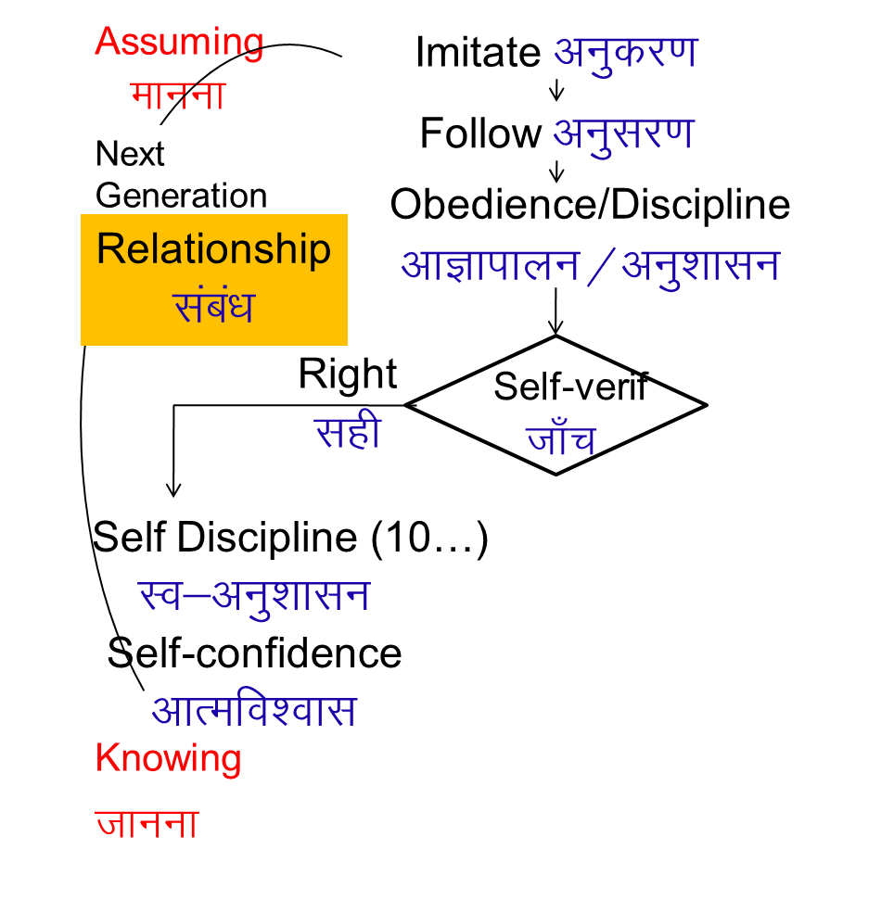
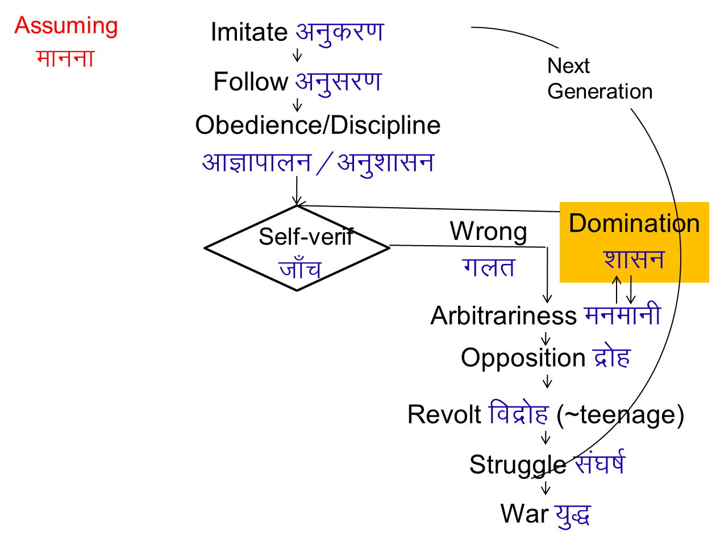

Process of Development – Relationship Process of Development – Domination
In an environment of Relationship
With parents and teachers having right understanding and right feeling
In an environment of Domination
With parents and teachers lacking right understanding and right feeling

Slide 23
Harmony in the Society: Order, from Family Order to World Family Order – Humane Society
Human Goal
(ekuo y{;)
Human Order ¼ekuoh; O;oLFkk½
Systems / Dimensions ¼vk;ke½
1. Education – Sanskar
2. Health – Self-regulation
3. Production – Work
4. Justice – Preservation
5. Exchange – Storage
Scope – From Family Order to World Family Order (Universal Human Order)
Family – Family cluster – Village – Village cluster/city ... Nation ... World Family
Order Order Order Order Order Order
~10¹ ~10² ~10¹⁰
Right Understanding & Right Feeling
Prosperity
Fearlessness
(Trust)
Co-Existence
(mutual fulfilment)
Happiness
In Every Individual
In Every Family
In Society
In Nature/ Existence
In UHV-II, we will discuss these systems in more detail

Slide 24
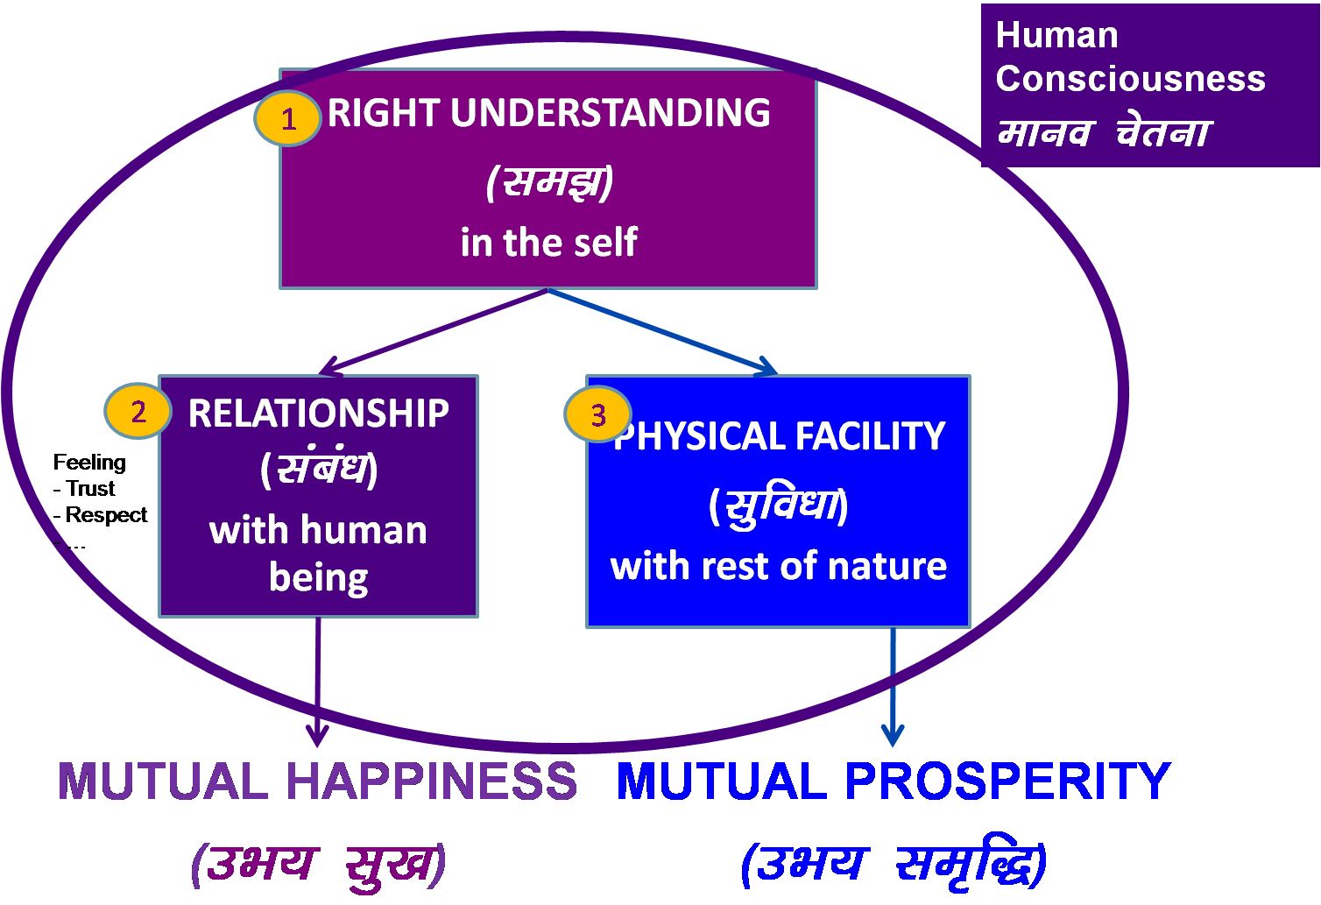
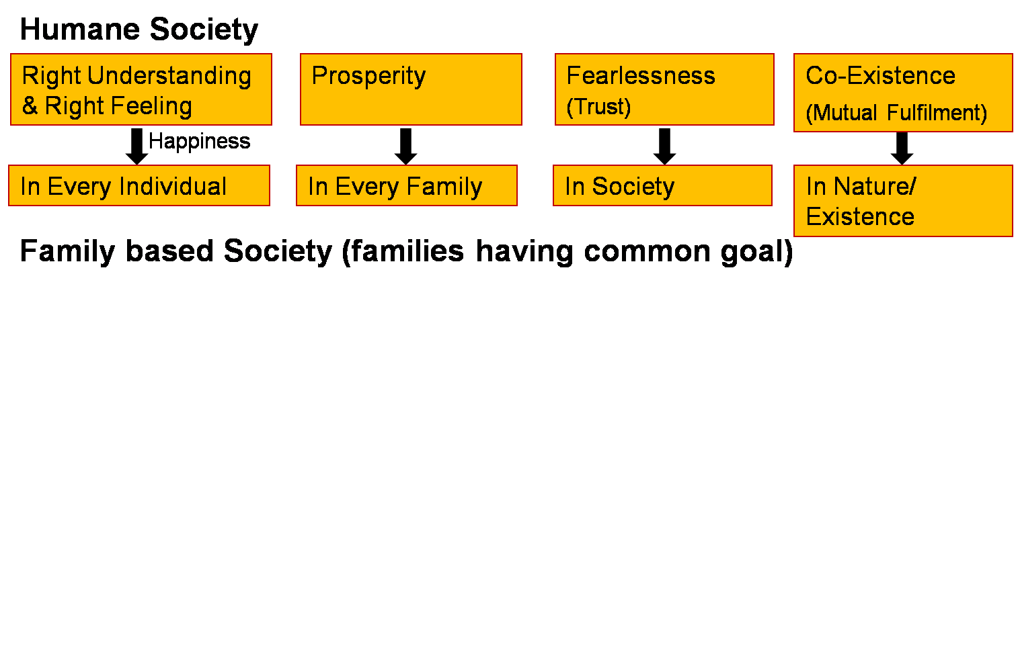
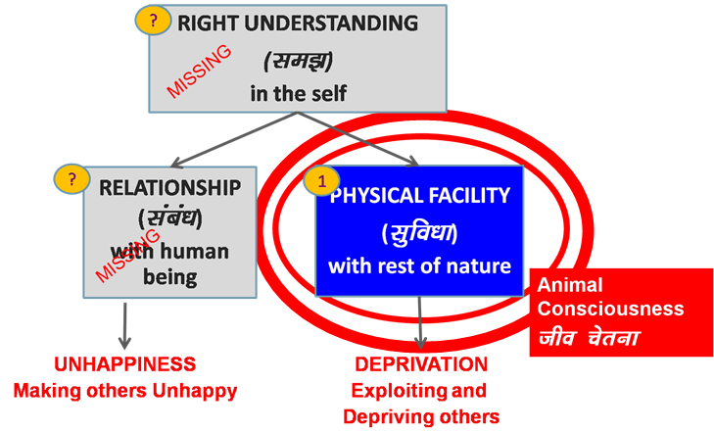
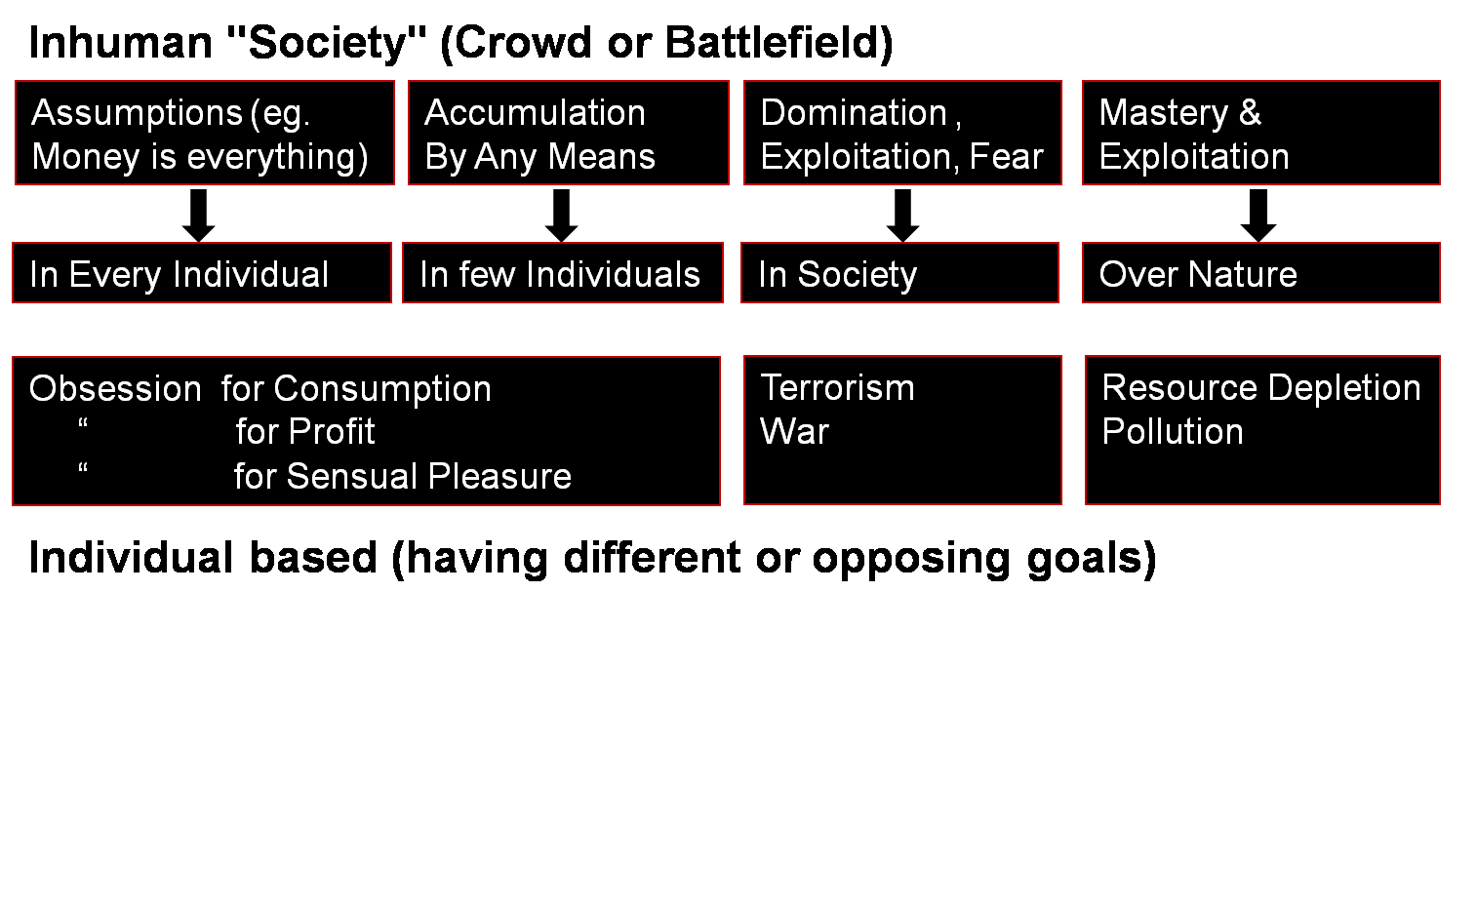
Who is responsible for the realization of the human goal?
For realizing the human goal, do we need to understand and participate actively?
Transformation& Progress
laØe.k&fodkl
Human Education
Personal Transformation
Societal Transformation

Slide 25
Sum Up
A society is composed of families living together, in a relationship of mutual fulfillment making effort for:
Right understanding & right feeling (happiness) in every individual
Prosperity in every family
Fearlessness (trust) in society
Co-existence (mutual fulfilment) in nature/existence
Through the participation of every family in the society, in the 5 dimensions or social systems, the human goal is fulfilled for all
– from family order to world family order
– generation after generation
Lack of effort towards human goal has led to problems at every level - With effort for the human goal, these problems can be solved holistically
My role in society is to contribute some of my time and effort for human goal
1. Education – Sanskar
2. Health – Self-regulation
3. Production – Work
4. Justice – Preservation
5. Exchange – Storage

Slide 26
Sum Up
At the level of society, we have a common goal
The common goal is to ensure right understanding and right feeling in every individual, prosperity in every family, fearlessness in the society and co-existence in the nature/existence
Lack of fulfillment of human goal has led to problems at every level
With effort for the common human goal, these problems can be resolved holistically
Having the clarity of a humane society (which is naturally acceptable to me), helps me in making effort in the family, institution, society

Slide 27
Home Assignment

Slide 28
Home Assignment
12.1. Look at your aspirations and map them to the human goal. What do you conclude from this?
12.2. Evaluate yourself on the 6 common graduate attributes.
You can do this exercise at every birthday and write down your progress year after year
12.3. Check your list of concerns. What is the root cause? Make a list of 5 things you can do to address the root cause
12.4. During your time in this institution (as a student), list 5 things you can contribute to complement your institution in realising the human goal

Slide 29
Questions?

